Slide 1
Food Ordering System
Data Structures & Algorithms

Slide 2
CONTENTS
01
Introduction
About the project
02
Implementation
Data Structure & Methodology
03
Applications
Where it can be used
04
Output
Screen shots and code
05
Future Improvements
Adding new / different features

Slide 3
INTRODUCTION
The customers of today are not only attracted because placing an order online is very convenient but also because they have visibility into the items offered, price and extremely simplified navigation for the order.
Online ordering system here, greatly simplifies the ordering process for both the customer and the restaurant.
System presents an interactive and up-to-date menu with all available options in an easy-to-use manner.
Customer can view all the order details in the cart before checking out.
Once the order is placed it is entered in the data-structure.
This allows Restaurant Employees to quickly go through the orders as they are received and process all orders efficiently and effectively with minimal delays and confusion.

Slide 4
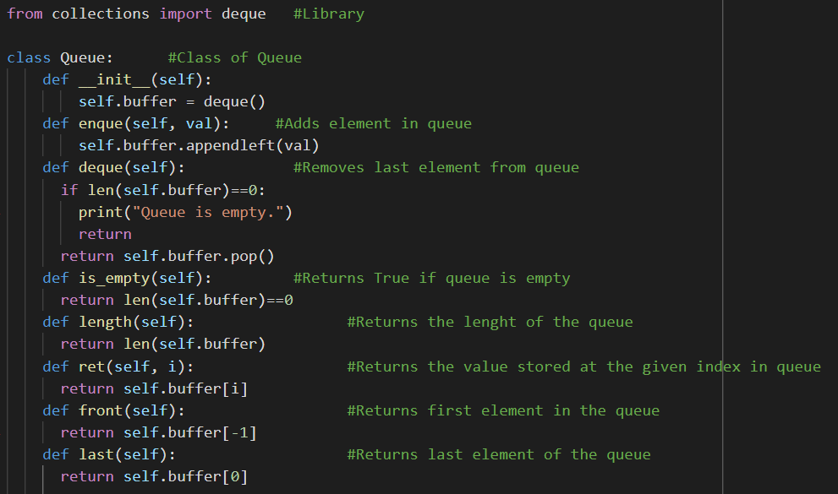
IMPLEMENTATION
I have used Queue Data Structure for the implementation of our project.
Queue uses FIFO (First In First Out) structure, here the order that is placed first will be served first and so on.
I have used functions of Queue such as Enqueue and Dequeue for adding and
removing from the queue.

Slide 5
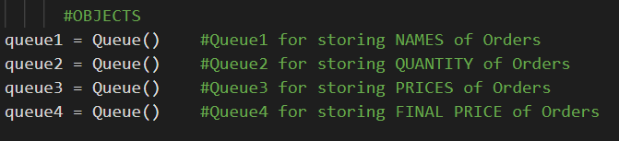
METHODOLOGY
I have used four Queues for our project.
Each queue stores different data
Queue 1 stores Name of the order
Queue 2 stores Quantity of the order
Queue 3 stores Price of the order
Queue 4 stores Final Price of the order
Each of the Queue, enqueues the new element / detail of the order in the respective Queues.

Slide 6
APPLICATIONS
There are numerous shops and different brands for foods all around the world.
Food Ordering System can be used everywhere and, in every shops, from
startups / small shops to large or branded food shops.
Apart for food ordering system it can also be edited to be used as any other type of ordering.

Slide 7
Hotels
Restaurant
Mess
Canteens
Food Stores
Grocery Stores
Applications
This system can be
used in any part of Food Industry such as,

Slide 8
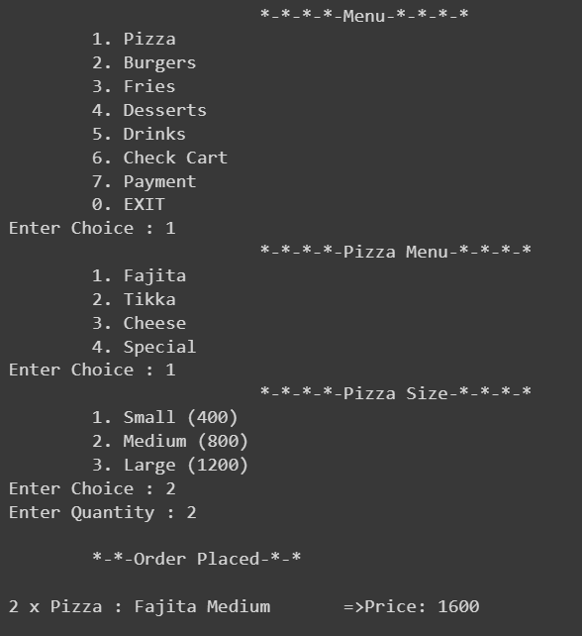
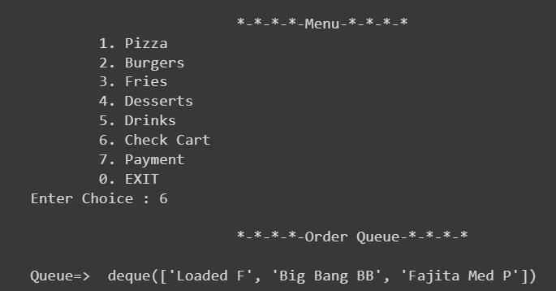
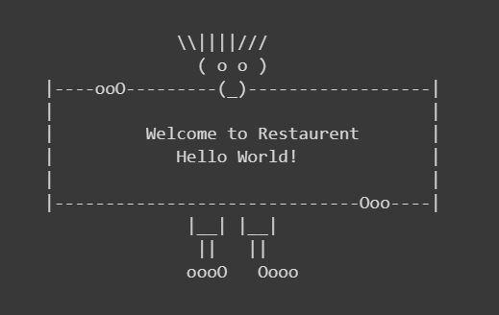
OUTPUTS

Slide 9
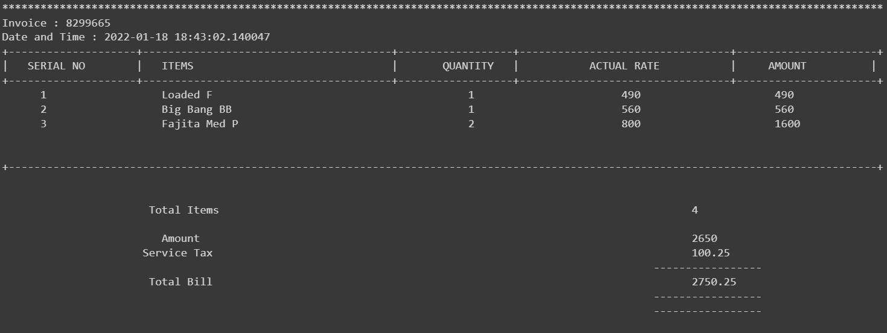
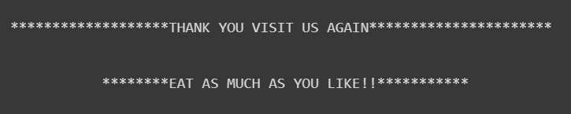
OUTPUTS

Slide 10
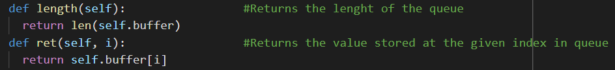
CODE
Instead of using deque function I have defined a new function name ret
that returns us the value at the specific index.
So, I print that value in the payment function in FIFO order the food that is ordered
first will be at the bottom of the payment receipt and later at top of the first order.
Thus, the last serial number is the first order that is placed, and the 1 serial number is
the last order placed in queue.

Slide 11
FUTURE IMPROVEMENTS
As now the project is based on just system.
In future I can make or switch this system into an application and website.
The application will be of the respective food shop that can be downloaded by the
users and they then can easily order food
from the application of the respective food shops.
Some of the future improvements include:
Visual graphical order status bar
Delivery options
Payment options via credit card, gift cards etc.,.
Restaurant Locator
Website for online ordering

Slide 12
THANK YOU!

